Slide 1
AI Smart Inventory Optimization
System architecture and methodology
AI-powered system to predict product demand, optimize inventory levels, and recommend optimal orders.
Integrates sales, inventory, supplier, product, promotion, and returns data.
Produces forecasts, reorder points, safety stock, order quantities, alerts, and management reports.
Core Objective
Reduce stockouts and excess inventory.
Decision Support
Generate data-driven inventory recommendations.
User Interface
Dashboards, alerts, reports, and role-based access.

Slide 2
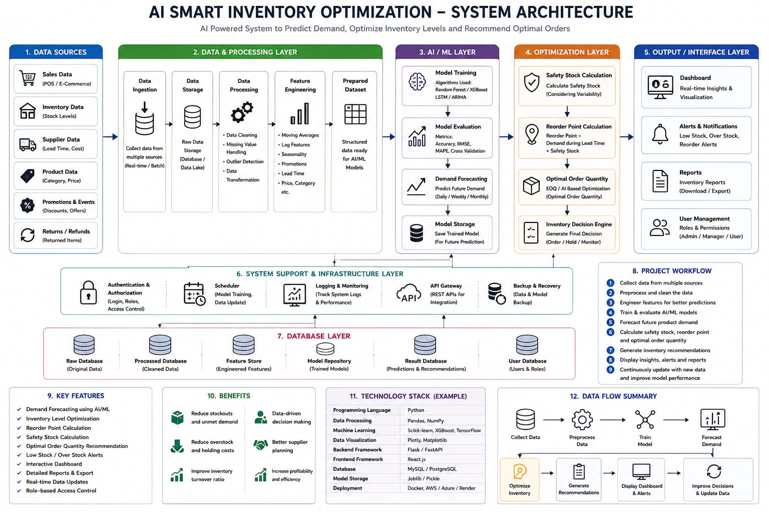
System Architecture
End-to-end architecture shown in the supplied reference

Slide 3
1. Data Sources
The system collects multiple operational data streams
Sales Data
POS / E-Commerce transactions
Sales history forms the primary demand signal.
Inventory Data
Stock levels
Provides current inventory position and availability.
Supplier Data
Lead time and cost
Supports reorder-point and purchasing decisions.
Product Data
Category and price
Adds product attributes for forecasting and segmentation.
Promotions & Events
Discounts and offers
Captures demand changes caused by promotions.
Returns / Refunds
Returned items
Helps account for demand reversals and inventory movement.

Slide 4
2. Data & Processing Layer
Transform raw operational data into a structured dataset for AI/ML
Data Ingestion
Collect data from multiple sources using real-time or batch ingestion.
Data Storage
Store raw data in a database or data lake for processing and reuse.
Data Processing
• Data cleaning
• Missing-value handling
• Outlier detection
• Data transformation
Feature Engineering
• Moving averages
• Lag features
• Seasonality
• Promotions
• Lead time
• Price/category
Prepared Dataset
Structured data ready for AI/ML models and forecasting.

Slide 5
3. AI / ML Layer
Train, evaluate, store, and use models for demand forecasting
Model Training: Apply algorithms such as Random Forest, XGBoost, LSTM, or ARIMA.
Model Evaluation: Measure performance using Accuracy, RMSE, MAPE, and cross-validation.
Demand Forecasting: Predict future product demand at daily, weekly, or monthly levels.
Model Storage: Save trained models so they can be reused for future predictions.
ML Pipeline
Prepared Dataset
↓
Model Training
↓
Model Evaluation
↓
Demand Forecasting
↓
Model Storage

Slide 6
4. Optimization Layer
Convert forecasts into practical inventory decisions
Safety Stock
Calculate safety stock using demand and variability considerations.
Reorder Point
Reorder Point = demand during lead time + safety stock.
Optimal Order Quantity
Use EOQ / AI-based optimization to determine the recommended order quantity.
Inventory Decision Engine
Generate final Order / Hold / Monitor recommendations.

Slide 7
5. Output / Interface Layer
Deliver recommendations in forms that support day-to-day decisions
Dashboard
Real-time insights and visualization of inventory and demand.
Alerts & Notifications
Low-stock, over-stock, and reorder alerts.
Reports
Inventory reports that can be downloaded or exported.
User Management
Roles and permissions for Admin, Manager, and User access.

Slide 8
6. Support & 7. Database Layers
Infrastructure services keep the system secure, observable, and recoverable
Authentication & Authorization — login, roles, and access control.
Scheduler — supports model training and data updates.
Logging & Monitoring — tracks system logs and performance.
API Gateway — REST APIs for integration with other systems.
Backup & Recovery — protects data and model assets.
Database layer — Raw Database, Processed Database, Feature Store, Model Repository, Result Database, and User Database.

Slide 9
8. Project Workflow
From raw data collection to continuous decision improvement
1
Collect data from multiple sources
6
Calculate safety stock, reorder point and optimal order quantity
2
Preprocess and clean the data
7
Generate inventory recommendations
3
Engineer features for better predictions
8
Display insights, alerts and reports
4
Train & evaluate AI/ML models
9
Continuously update with new data and improve model performance
5
Forecast future product demand

Slide 10
9. Key Features & 10. Benefits
Functional capabilities and expected operational value
Key Features
• Demand forecasting using AI/ML
• Inventory level optimization
• Reorder point calculation
• Safety stock calculation
• Optimal order quantity recommendation
• Low-stock / over-stock alerts
• Interactive dashboard
• Detailed reports & export
• Real-time data updates
• Role-based access control
Benefits
• Reduce stockouts and unmet demand
• Reduce overstock and holding costs
• Improve inventory turnover ratio
• Enable data-driven decision making
• Support better supplier planning
• Increase profitability and efficiency

Slide 11
11. Technology Stack (Example)
Technology choices represented in the supplied architecture
Programming Language: Python
Data Processing: Pandas, NumPy
Machine Learning: Scikit-learn, XGBoost, TensorFlow
Data Visualization: Plotly
Backend Framework: Flask / FastAPI
Frontend Framework: React.js
Database: MySQL / PostgreSQL
Model Storage: Joblib / Pickle
Deployment: Docker, AWS / Azure / Render

Slide 12
12. Data Flow Summary
The complete decision loop
Collect Data
Sales, inventory, supplier, product, promotion and returns
Preprocess Data
Clean, transform and engineer features
Train Model
Train and evaluate forecasting models
Forecast Demand
Generate future demand estimates
Optimize Inventory
Calculate safety stock, reorder point and order quantity
Generate Recommendations
Order / Hold / Monitor
Display Dashboard & Alerts
Present insights to users
Improve Decisions
Update data and improve model performance

